Slide 1
Final touches
Is it ever really done?

Slide 2
Practical information
We have one assignment which will be graded at the end of the course, upon submission
After each lesson, you will be able to implement a part of the assignment
We recommend to do it gradually
At the beginning of each lesson, we will do a "refresher" of the previous topic. Come with a smartphone
Each lesson includes some practice. Be here with a laptop and enough battery
Tooling:
VS Code or IntelliJ Idea
Java 21
Git
Setup everything by using the "cook-books" from oop-2: https://appliedmath.toi.inholland.nl/oop-2-code-projects/cook-books

Slide 3

Reflection

Slide 4
Objectives
Recap past topics
Set expectations for assignment
Cover a few topics that could help you

Slide 5
Objectives
Code examples can be found here

Slide 6
Configuring configurations
Avoid hard coding values
Enable environment specific values
Centralize settings

Slide 7
Application.properties
Automatically included with a spring project
Default place spring framework looks for properties
Located in src/main/resources
Can also be application-properties.yaml

Slide 8
Using properties in your application
Case by case
@Value
DO NOT COMMIT API KEYS
Use a placeholder
Supply us with the api keys when you submit your assignment
@Value("${external.api.url}") private String apiUrl; @Value("${external.api.key}") private String apiKey;
external.api.url=https://api.peopleinfo.com/v1 external.api.key=${EXTERNAL_API_KEY}

Slide 9
Using properties in your application
Configuration class
@ConfigurationProperties
Easier to test
Cleaner for grouped properties
@Getter @Component @ConfigurationProperties(prefix = "external.api") public class ExternalApiProperties { private String url; private String key; }

Slide 10
Environment specific
Separate properties file per environment
Configuration can be specific
Connection url’s, connection strings
Keys
Passwords

Slide 11
Validation
Use Jakarta.validation framework
Check if a configuration value is not null
Can also be used for validation of data in your model
What values should never be empty?

Slide 12

Unit test recap
Verify the behavior of a small unit of code (usually a method)
Should test for happy flows and unhappy flows
Outcome should always be the same with the same input

Slide 13
Refactoring streams
Refactoring: change how code works, not what it does!
Implement getting the email address of all adults in our repository
Use multiple filters
Age
nullcheck
Extract methods to increase readability

Slide 14
Successful refactor
Unit tests should still pass!
Refactoring should not change functionality
Keep names clear

Slide 15

Short break – See you in 5 minutes

Slide 16
Grading
7 topics
Focus on code quality and functionality

Slide 17
Git Usage
Similar to OOP 2
Use branches
Commit often
Titles should be descriptive

Slide 18
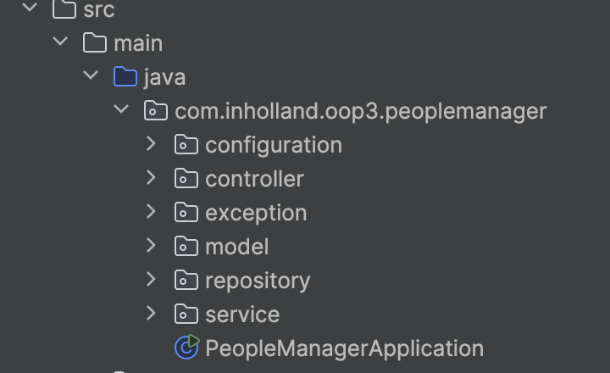
Application Architecture
Use MVC structure
Create separate packages
Keep logic in the service
Use DTO’s to present data to the outside world
Classes should have logical names
Use the standard naming convention

Slide 19
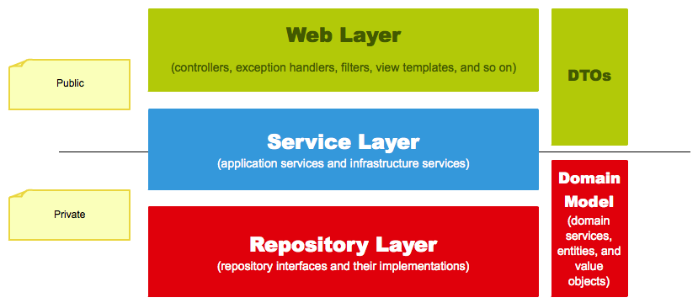
Model – View – Controller Architecture
(entities and value objects)

Slide 20
Aspect Oriented Programming
Aspect
Intercept
Usually it takes a big effort to implement, but if it’s provided by the framework, it’s easy and useful.
The purpose is to centralize cross cutting concerns, keeping other classes clean.
Intercepts method calls and can execute code before, after and/or on uncaught exceptions
Instance
Method call
Return
Uncaught exceptions

Slide 21
Frameworks
Use frameworks
Avoid boilerplate code

Slide 22
Unit testing
Coverage should be >90%
Use a plugin to measure coverage
Tests should make logical assertions
Use mutation testing to indicate that tests are usefull

Slide 23
Streams api
Streams are used in your application
Order of the interactions makes sense

Slide 24
Short break – See you in 5 minutes

Slide 25
Code quality and documentation
Comments explain your thought process and choices
Code should be readable without comments
Readme file describes
Which endpoint does what
How to run your application
Methods and variable have clear names

Slide 26
Build and run quality
Application should run out of the box
All unit tests should pass
Check this yourself!

Slide 27
VSCode Productivity
Shortcuts save you time and frustration!
Auto formatting
Shift+alt+F / shift+option+F
Optimize imports
Ctrl+Shift+O / shift+option+O
Rename
F2

Slide 28
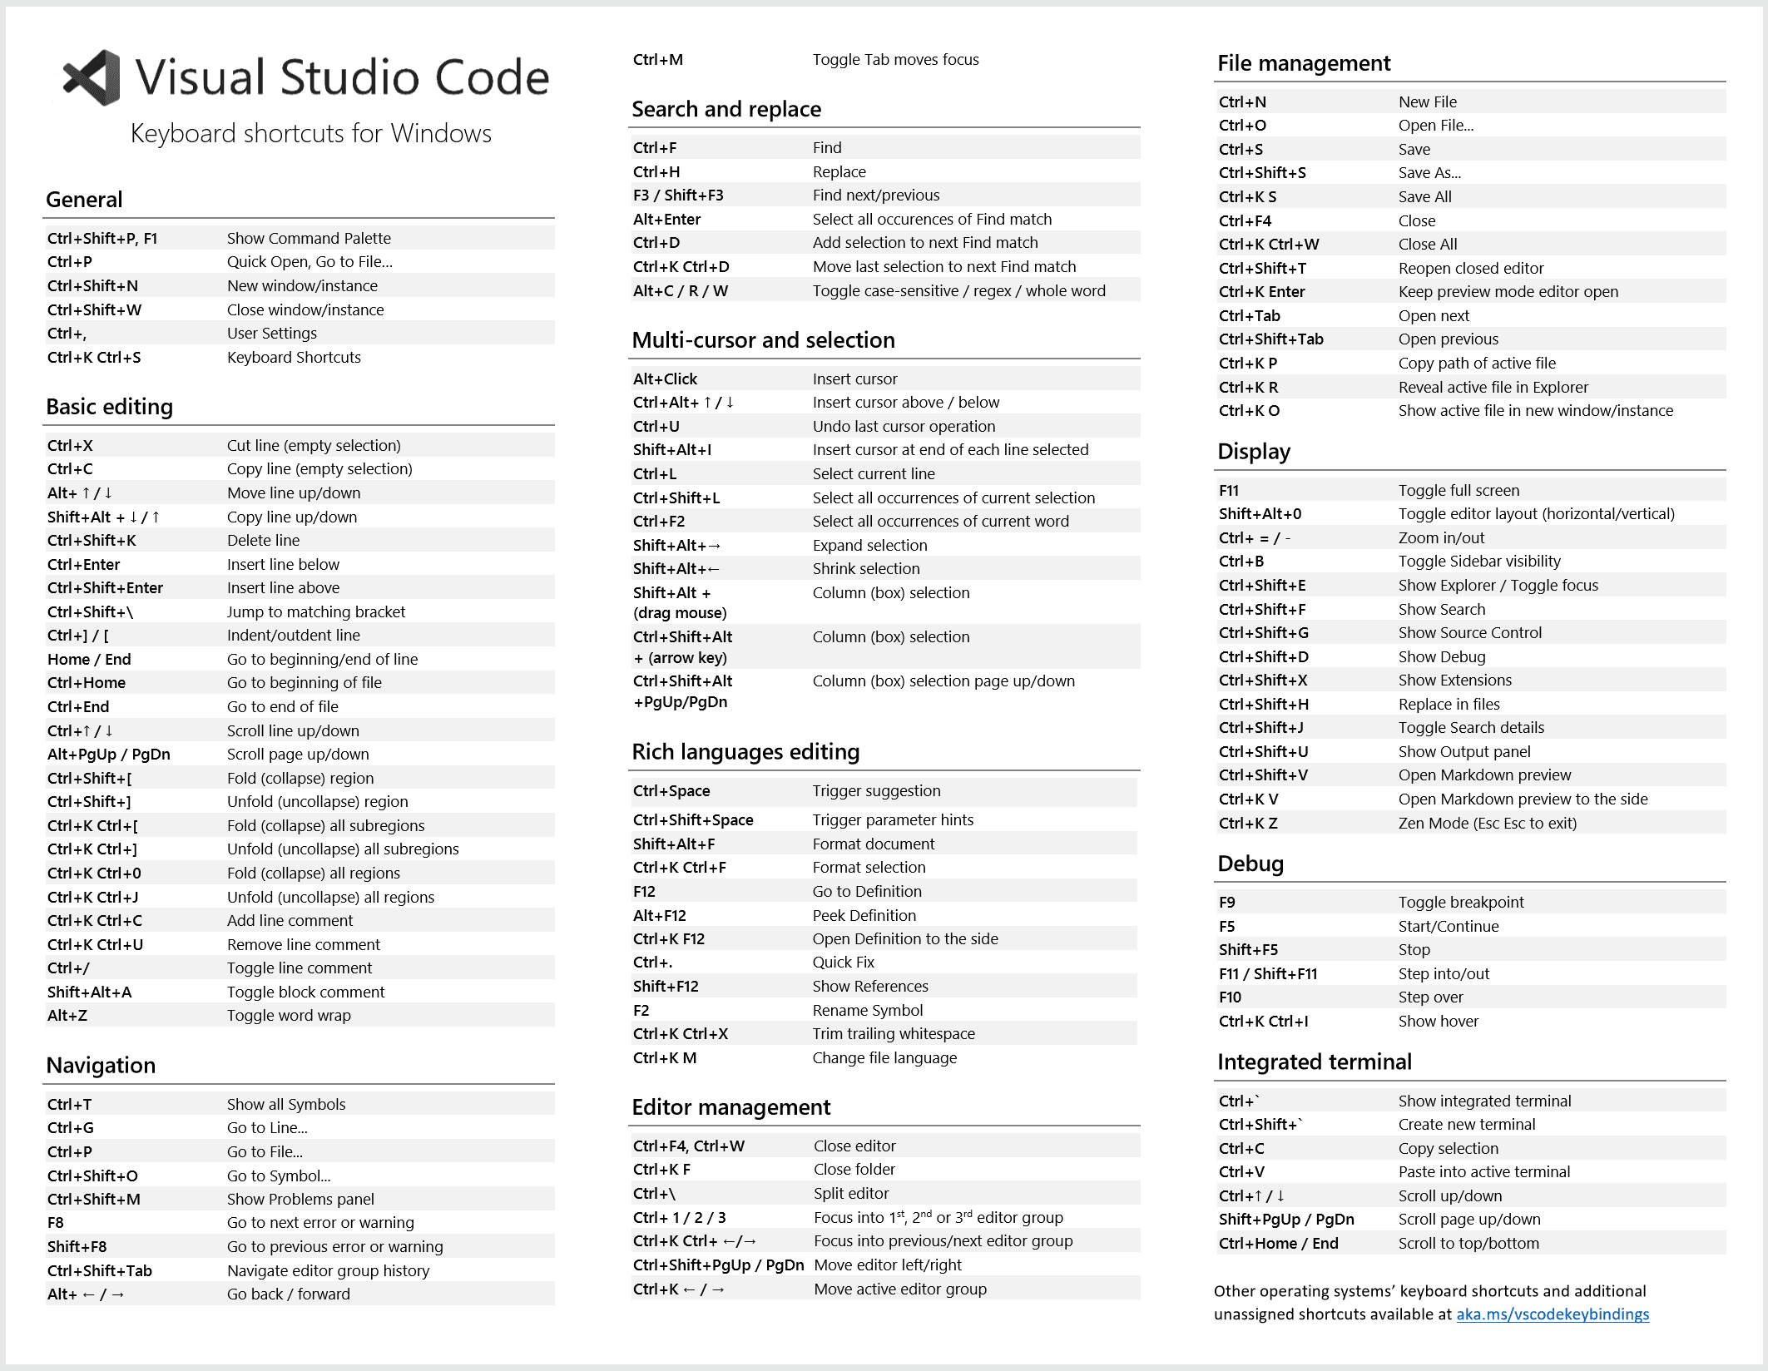
VSCode Productivity

Slide 29

Questions?

Slide 30
Homework
Finish up your application!
Hand in on Moodle by June 14th
Provide a link to your PUBLIC repository in Moodle
Provide any api keys that are referenced in your properties file in Moodle as well

